Slide 1
Encoders

Slide 2
What can encoders track?

Slide 3
Types of Drive Encoders
Drive Encoder Localization
Two-Wheel Odometry Pods
Three-Wheel Odometry Pods

Slide 4
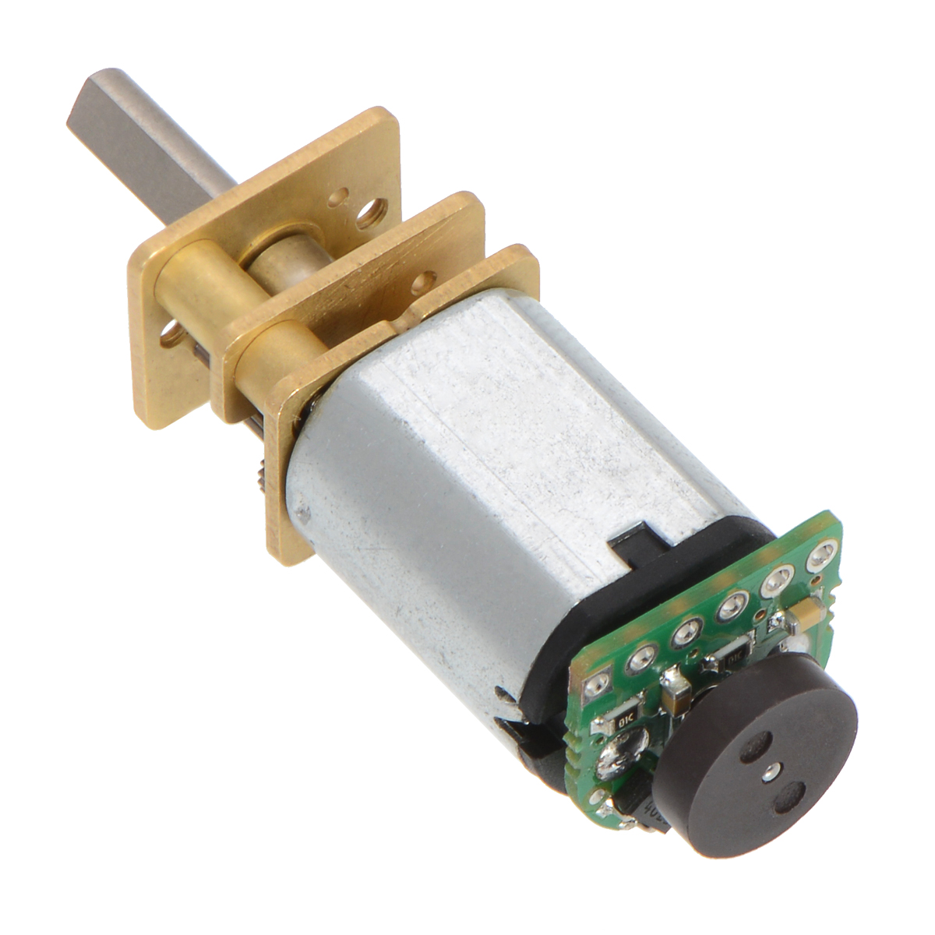
Drive Encoder Localization
Pros:
Cheap (the motors you’re using most likely already have encoders built in)
Accessible
Little configuration necessary
Cons:
Drive encoder localization on mecanum drive can be quite inaccurate due to lack on traction on mecanum wheels.
Will drift on high acceleration on mecanum drive. Accuracy will be good enough for basic autonomous modes if acceleration is limited

Slide 5
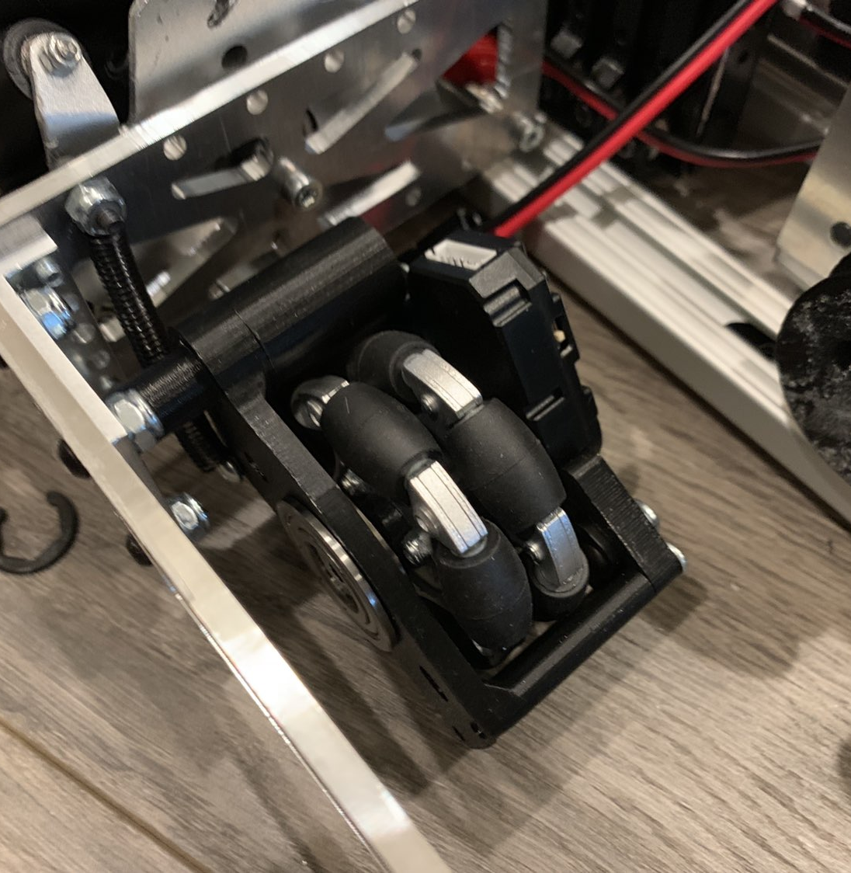
Two-Wheel Odometry Pods
Pros:
Cheaper than 3-wheel design
Good accuracy
No tuning of the heading necessary
Cons:
Subject to more drift than the 3-wheel design

Slide 6
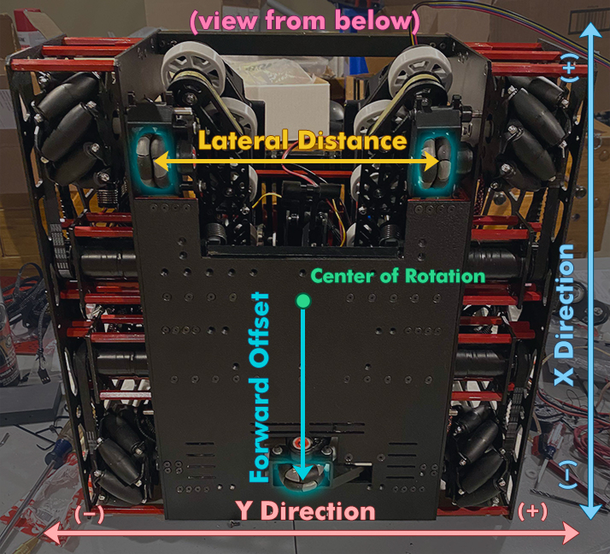

Slide 7
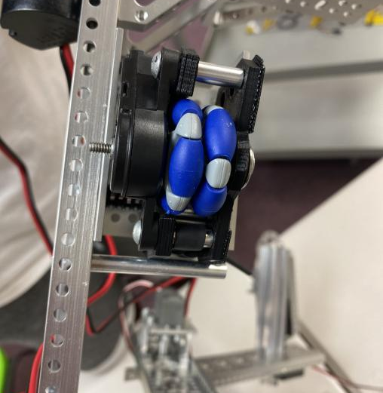
Three-Wheel Odometry Pods
Pros:
Relatively accurate tracking.
Greater accuracy in autonomous
Cons:
Expensive
Tuning of the heading is very important

Slide 9
Absolute vs Relative Encoder
Notes:
What is an Absolute Encoder?
An absolute encoder is used to provide a unique position value of shaft or data word at each point of revolution to represent the “absolute” position of the encoder.

